Slide 1
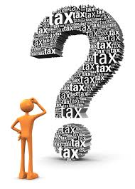
INCOME TAX
Dr. Ajit Ashte,
Asst. Prof. Dept of Commerce,
Shivaji Mahavidylaya,
Omerga, Dist. Osmanabad
Mobile 9423740707

Slide 2
Brief History of Income Tax in India:
In India, this tax was introduced for the first time in 1860, by Sir James Wilson in order to meet the losses sustained by the Government on account of the Military Mutiny of 1857.
In 1918, a new income tax was passed and again it was replaced by another new act which was passed in 1922.This Act remained in force up to the assessment year 1961-62 with numerous amendments.
In consultation with the Ministry of Law finally the Income Tax Act, 1961 was passed. The Income Tax Act 1961 has been brought into force with 1 April 1962. It applies to the whole of India and Sikkim (including Jammu and Kashmir).
Since 1962 several amendments of far-reaching nature have been made in the Income Tax Act by the Union Budget every year.

Slide 3
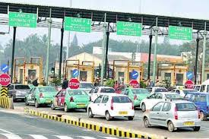

Slide 4
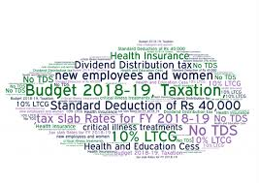
Tax Slab
Education Cess 3% +Health Cess of1 %
Surcharge of 10% on Rs. 50 Lakhs to Rs. 1 crore + Income earners
Surcharge of 15% on Rs. 1 Cr. Plus income earners
Tax credit of Rs. 2,500/- for income upto Rs. 3.5 Lakhs u/s 87A
Standard deduction of Rs. 40,000/-for Salaried and Pensioners
There are no separate slab for male & Female

Slide 6
Important Terms
Assessee
Assessment Year (A.Y. 2019‐20)
Previous Year (F.Y. 2018‐19)
Residential Status
Gross Total Income
Deductions
Total Income

Slide 7
Gross Total Income
Deductions
Total Income

Slide 8
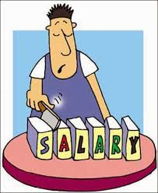
HEADS OF INCOME
Income From Salary
Meaning of Salary:
Wages;
Pension;
Annuity;
Gratuity;
Advance Salary paid;
Fees, Commission, Perquisites, Profits in lieu of or in addition to Salary or Wages;
Annual accretion to the balance of Recognized Provident Fund;
Leave Encashment;
Transferred balance in Recognized Provident Fund;
Contribution by Central Govt. or any other employer to Employees Pension A/c as referred in Sec. 80CCD.

Slide 9
Income from Salary
Particulars | Amount
Basic Salary | —
Add: | —
1. Fees, Commission and Bonus | —
2. Allowances | —
3. Perquisites | —
4. Retirement Benefits | —
5. Fees, Commission and Bonus | —
Gross Salary | —
Less: Deductions from Salary | —
1. Entertainment Allowance u/s 16 | —
2. Professional Tax u/s 16 | —
Net Salary | —

Slide 10
Income from House Property
Particulars | Amount (Rs.)
Gross Annual Value | xxx
Less: Municipal taxes | (xxx)
Net Annual Value | xxx
Less: Deductions u/s 24 Standard deduction Deduction on interest paid | (xxx) (xxx)
Taxable income from house property
Deductions: 1. Standard Deduction u/s 24@30% of Annual Value
2. Interest paid on home loan( Max Rs. 200,000/-)
3. Loan Principle payment u/s 80C
4. Deduction for fist time home buyer u/s 80EE

Slide 11
Income from Other Sources
1.) Income:
Dividend
Interest- From Savings, Term deposit, income tax refund, other
Income of winnings from lotteries, crossword puzzles etc., excluding income from owning race horses
Income from the activity of owning and maintaining race horses

